Slide 1
PROJECT NAME
Employee Retention
Domain : HR Analytics
Created by :
Vijayalaxmi Gangade

Slide 2
Agenda
Introduction
Data Analysis Process and tools used
Problem Statement
KPI’s Charts and Insights
​Dashboard
Recommended Solution​
Conclusion

Slide 3
Introduction
HR analytics is the process of collecting and analyzing data related to human resources and their impact on business outcomes. HR analytics can help organizations make better decisions about hiring, retention, performance, learning, and development. HR analytics can also help measure the effectiveness of HR policies and interventions, provide insights for improvement and innovation.
HR Analytics consist of 4 types which are Diagnostic Analysis, Descriptive Analysis, Predictive Analysis, Prescriptive Analysis

Slide 4
Data Cleaning
Data Integration(Merge)
EDA(Exploratory Data Analysis)
Visualisation

Slide 5
Tools Used
Excel
Power Bi
Tableau
SQL

Slide 6

Problem Statement
Employee attrition is a major challenge for the company, as it leads to loss of talent, productivity, and revenue. The company needs to understand the factors that influence employee attrition and retention, and develop strategies to reduce turnover and increase employee engagement and satisfaction.

Slide 7
Overall Data
Total EMPLOYEES
50,000
Total Female
24941
Total Male
25059
Attrition Rate
50.21%
Total Attrition’s
25105
Active Employees
24895
Female Attrition
12,560
Male Attrition
12,545

Slide 8
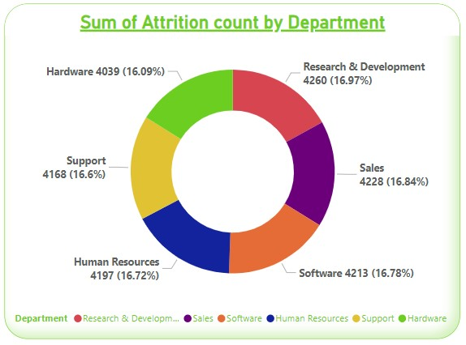
KPI – 1.
﻿At 4260, Research & Development had the highest Sum of Attrition count and was 5.47% higher than Hardware, which had the lowest Sum of Attrition count at 4039.
Research & Development accounted for 16.97% of Sum of Attrition count.
﻿Across all 6 Department, Sum of Attrition count ranged from 4039 to 4260.

Slide 9
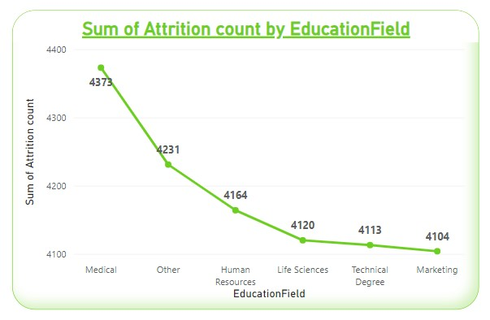
KPI - 2
At 4373, Medical had the highest Sum of Attrition count and was 6.55% higher than Marketing, which had the lowest Sum of Attrition count at 4104.
﻿Medical accounted for 17.42% of Sum of Attrition count.
﻿﻿Across all 6 EducationField, Sum of Attrition count ranged from 4104 to 4373.﻿﻿ ﻿

Slide 10
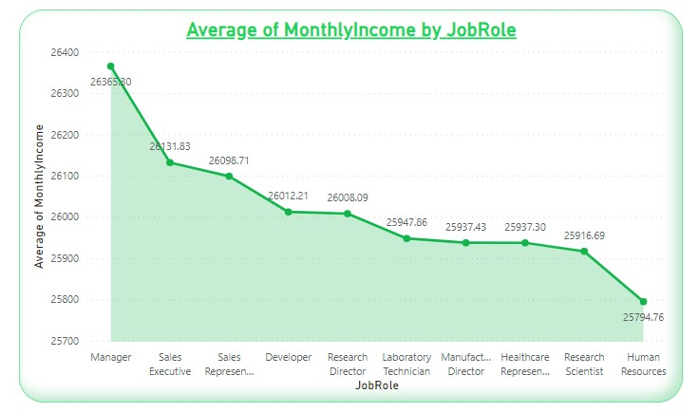
.
KPI - 3
At 26,365.30, Manager had the highest Average of MonthlyIncome and was 2.21% higher than Human Resources, which had the lowest Average of MonthlyIncome at 25,794.76.
Across all 10 JobRole, Average of MonthlyIncome ranged from 25,794.76 to 26,365.30.﻿

Slide 11
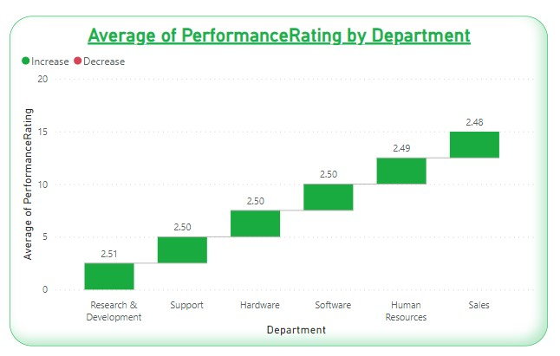
KPI - 4
At 2.51, Research & Development had the highest Average of PerformanceRating and was 1.08% higher than Sales, which had the lowest Average of PerformanceRating at 2.48
﻿Across all 6 Department, Average of PerformanceRating ranged from 2.48 to 2.51..﻿

Slide 12
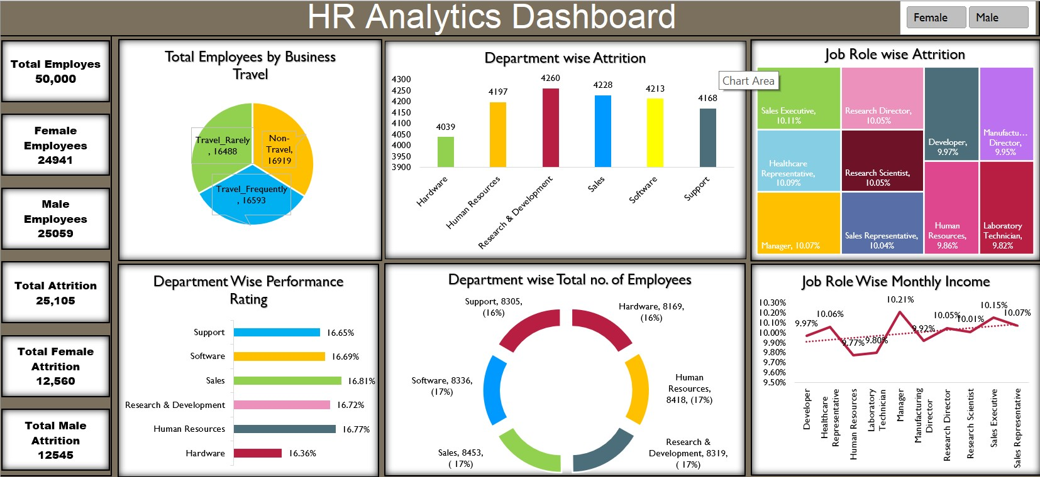
Excel Dashboard
https://github.com/Laxmigangade/Data-Analyst-Project

Slide 13
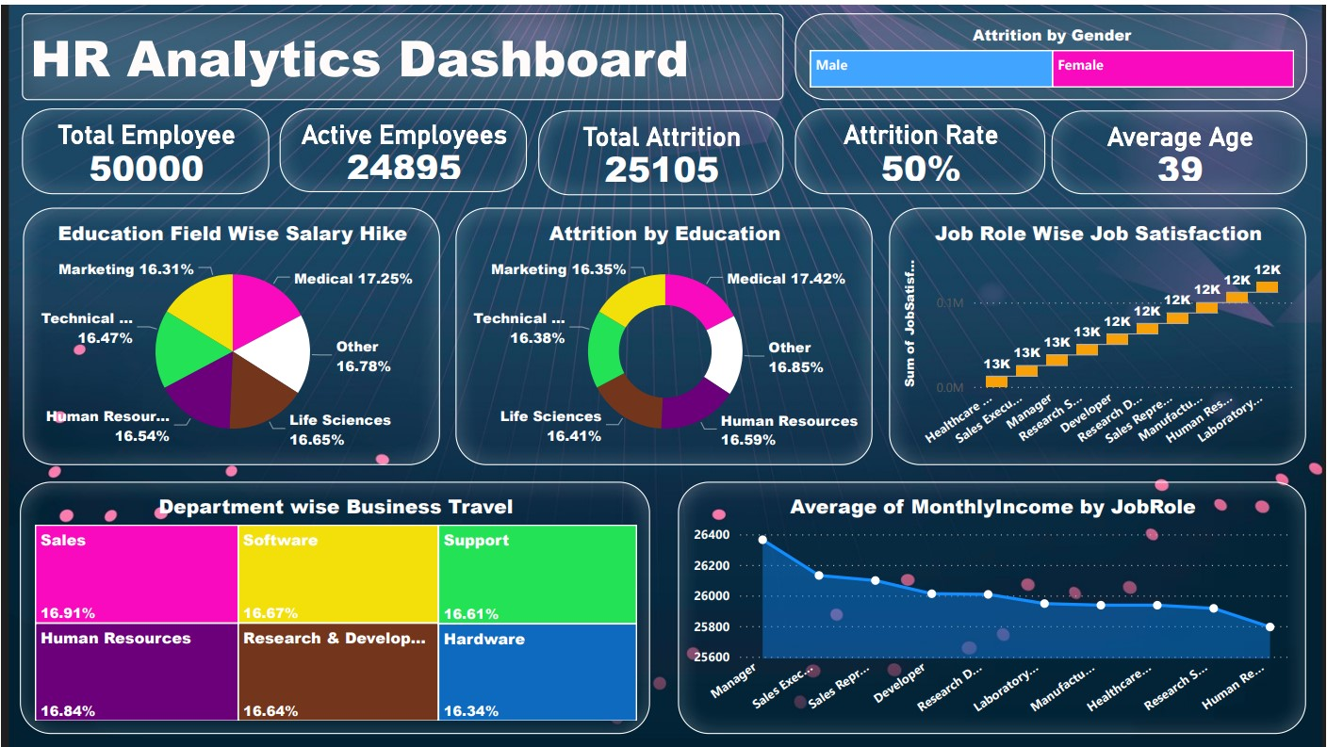
Power BI Dashboard
https://github.com/Laxmigangade/Data-Analyst-Project

Slide 14
Lessons
The hr_1 and hr_2 datasets can provide you with valuable insights and information about your human resources and employee attrition, such as the, behaviors, performances and preferences of your employees, the factors and drivers of their performance and satisfaction, and the risks and opportunities for their retention and development.
The hr_1 and hr_2 datasets can enable you to enhance your data analysis and visualization skills and competencies, such as the use of various tools and software, such as SQL, Excel, Tableau and Power BI, the application of various techniques and methods, such as descriptive, diagnostic, predictive, and prescriptive analytics, and the communication and presentation of your data insights and recommendations to your stakeholders, such as managers, executives, and employees.

Slide 15
Challenges Faced
The hr_1 and hr_2 datasets have different columns, which may require some data integration and transformation before you can combine and analyze them.
The hr_1 and hr_2 datasets have many variables and dimensions, which may make it difficult to identify the most relevant and important factors and patterns for your business objectives and questions. You may need to apply some data reduction and selection techniques to simplify and focus your data analysis and visualization.

Slide 16
Recommended solution
Reasons for Departure:
Categorize and analyze the reasons why employees leave, such as career growth opportunities, compensation, work-life
balance, or leadership issues.
Engagement Surveys and Feedback:
Incorporate data from employee engagement surveys and feedback mechanisms to understand employee satisfaction and identify areas for improvement.
Performance Metrics:
Include performance metrics to evaluate the correlation between performance and retention. High performers leaving might indicate issues with recognition or career development.
Training and Development:
Monitor the participation and completion rates of training and development programs to gauge their impact on employee satisfaction and retention.
Promotion Rates:
Track the rates of internal promotions to evaluate the effectiveness of your internal talent development programs.
Salary and Benefits Benchmarking:
Compare your organization's salary and benefits against industry benchmarks to ensure you remain competitive in the market.

Slide 17
In conclusion the HR analytics can provide valuable benefits to both employees and employers such as by improving employee engagement and satisfaction, reducing employee turnover and attrition, improving employee well-being, enhancing employee performance and productivity and saving costs and increasing revenue So, the solution would be of offering incentives, giving promotion , creating good environment among employees also assigning some days as work from home to employees having long travelling distance
Conclusion

Slide 18
Thank you

